Slide 1
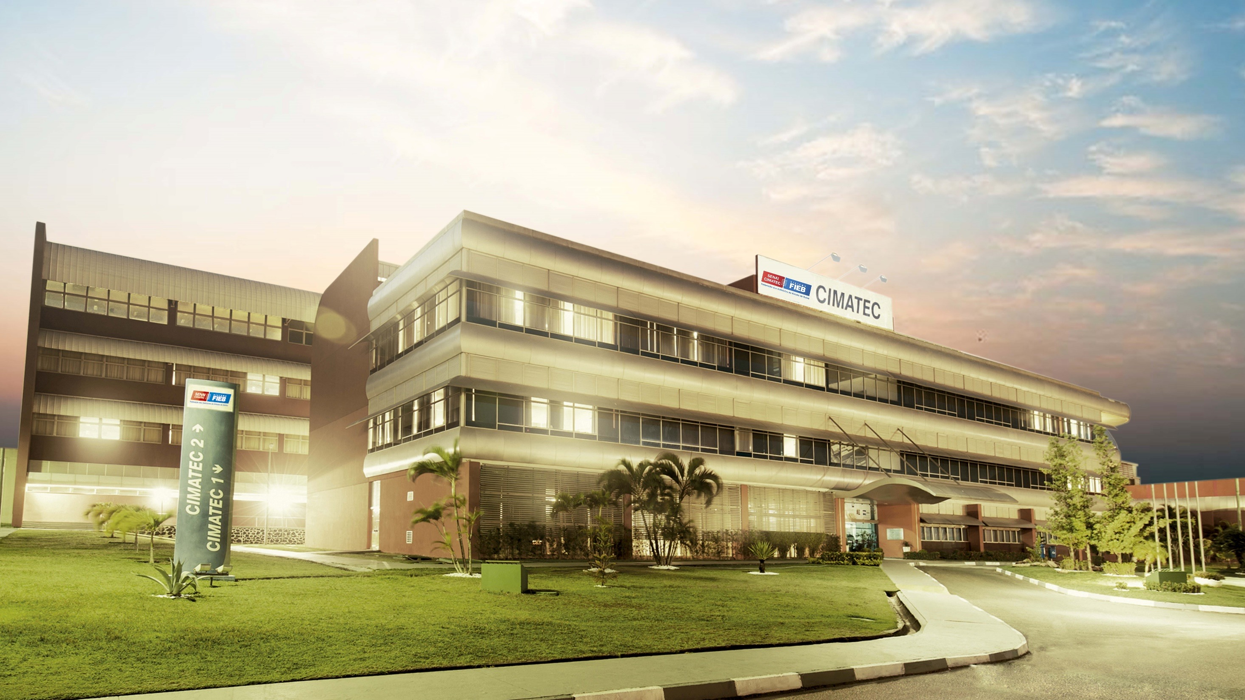






Slide 2
GPU Programming Applied to Industrial Problems
Introduction to scaling multi-node applications
Murilo Boratto

Slide 3

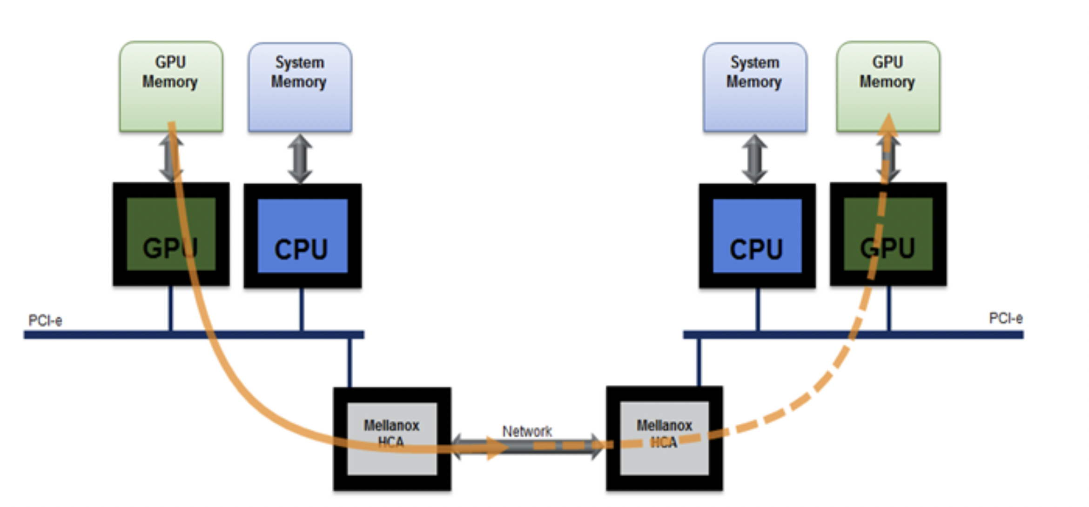
Multi-GPU Environments

Slide 4
Multi-GPU Environments
CUDA
OPENACC
OPENMP
NCCL
NVLINK
RDMA
UCX
MPI+CUDA
GPUDirect
INFINIBAND (MELLANOX)
CUDAWARE
NVSHMEM

Slide 5
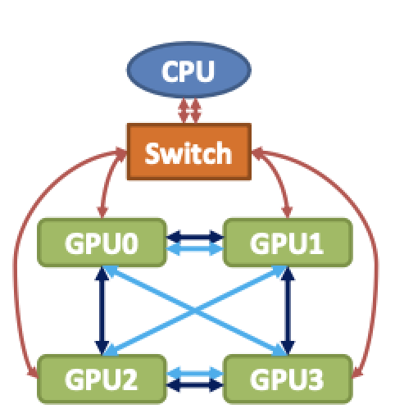
Multi-GPU Nodes

Slide 6
Multi-GPU Nodes
NVLINK
NVLINK
NVLINK
NVLINK
NVLINK

Slide 7
Multi-GPU Nodes
PCI
NVLINK
NVLINK
NVLINK
NVLINK
NVLINK
NVLINK
NVLINK
NVLINK
NVLINK
NVLINK

Slide 8
Multi-GPU Nodes
INFINIBAND (MELANOX)
NVLINK
NVLINK
NVLINK
NVLINK
NVLINK
NVLINK
NVLINK
NVLINK
NVLINK
NVLINK

Slide 9
Multi-GPU Nodes
UCX (Unified Comunication X Library)
INFINIBAND (MELANOX)
NVLINK
NVLINK
NVLINK
NVLINK
NVLINK
NVLINK
NVLINK
NVLINK
NVLINK
NVLINK

Slide 10
NCCL
NVIDIA Collective Communication Library

Slide 11
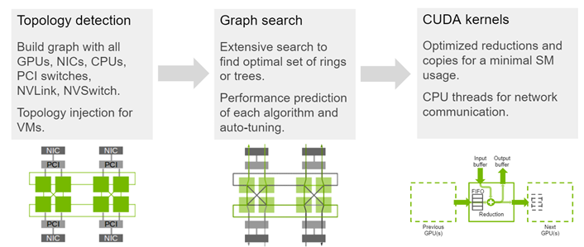
NCCL

Slide 12
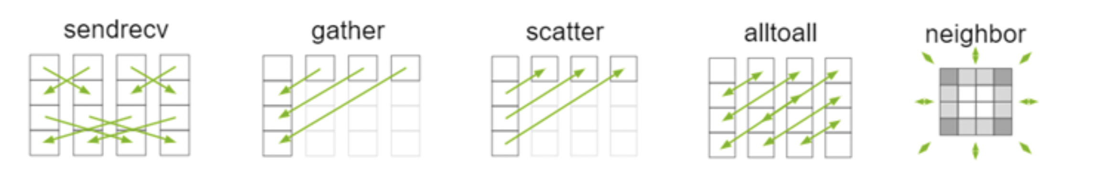
NCCL

Slide 13
CUDAWARE MPI
CUDA + MPI at GPUs

Slide 14
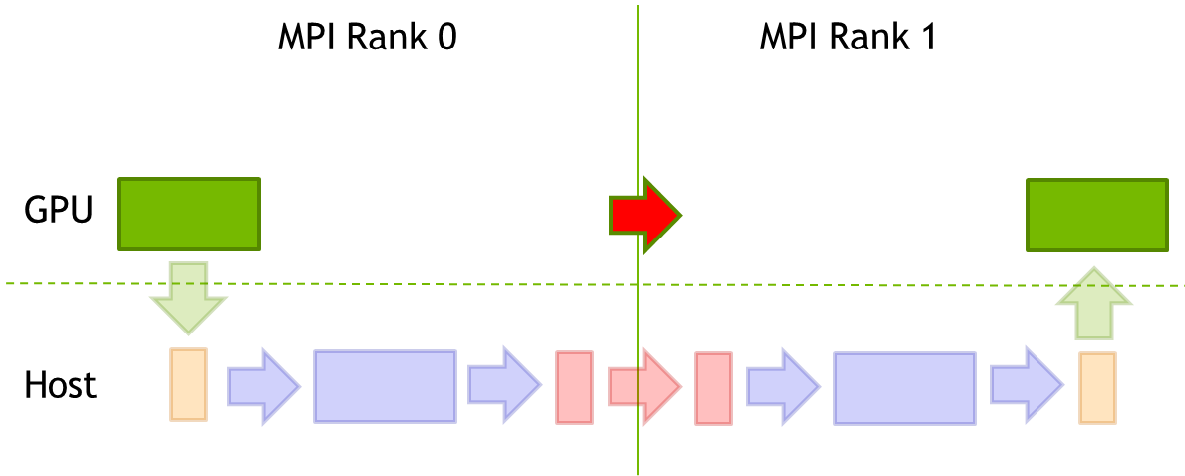
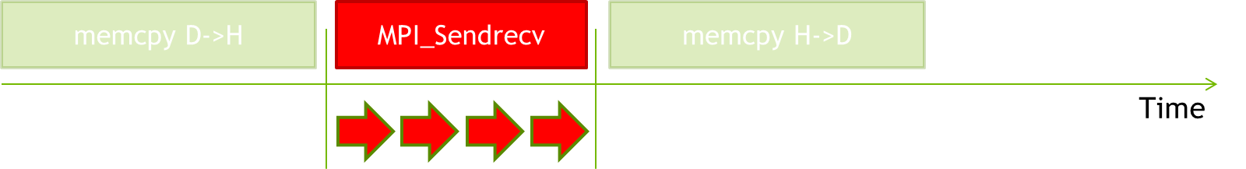
CUDAWARE-MPI

Slide 15
NVSHMEM
NVIDIA OpenSHMEM

Slide 16
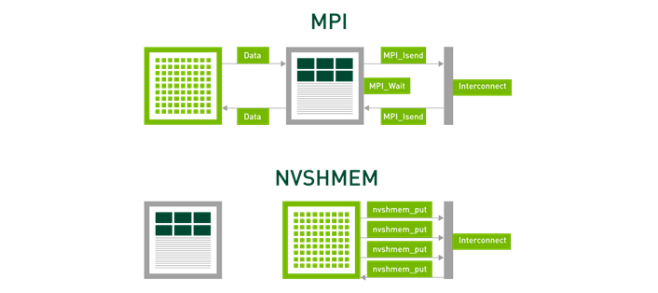
NVSHMEM

Slide 17
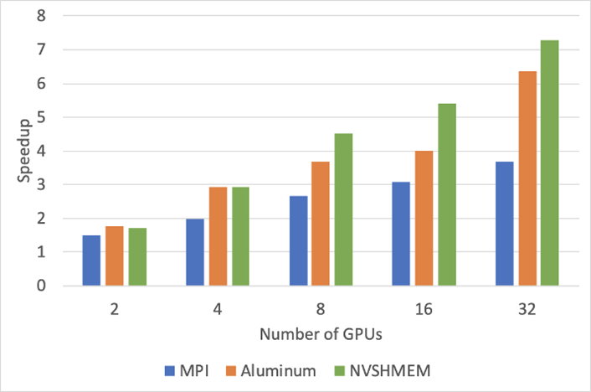
NVSHMEM

Slide 18
https://github.com/muriloboratto/parallel-computing-applied

Slide 19
https://github.com/muriloboratto/GPU-programming

Slide 20
Murilo Boratto
murilo.boratto@fieb.org.br

